Slide 1



a) Plasmid representation
MHCI construct
SP
Peptide
Linker
β2M
Linker
MHC-HC
Linker
Aga2
Y84A
MHCII construct (mini)
SP
Peptide
Linker
MHCβ1
Linker
MHCɑ1
Linker
Aga2
MHCII construct (full length)
SP
MHCɑ
Linker
P2A
SP
Peptide
Linker
MHCβ
Linker
Aga2
b) Surface representation
MHCI construct
MHCII construct (mini)
MHCII construct (full length)
Figure 1. Formatting of yeast display constructs a) in plasmids and b) on yeast surface. Abbreviations: SP = signal peptide; MHC-HC = MHCI heavy chain; β2M = beta-2-microglobulin

Slide 2

Validating MHC Folding on Yeast
Identify MHC and TCR of interest.
Has this MHC previously been expressed on yeast?
Yes
No
Proceed with making library.
Does this MHC have a known TCR+peptide ligand?
Yes
No
Express pMHC on yeast and test for binding (tetramer staining or tag enrichment).
Cannot determine if MHC is folded.
Is there binding?
Yes
No
Proceed with making library.
Make error prone library and select.
Install stabilizing mutations.
Figure 2. Flow chart for validating a yeast display construct.

Slide 3
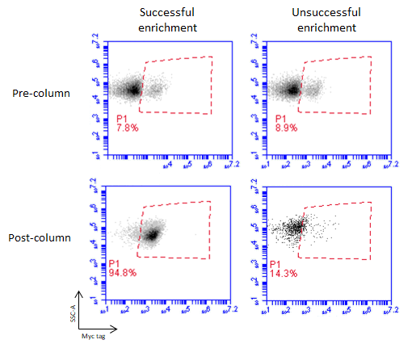
Figure 3. Example flow cytometry plots showing Myc tag staining pre- and post-selection with 400nM TCR-loaded streptavidin beads. The left column shows a successfully enriched population of pMHC-expressing yeast, suggesting that the construct is properly folded on the surface of the yeast. The right column shows an unsuccessful enrichment, suggesting that the construct is not properly folded.

Slide 4
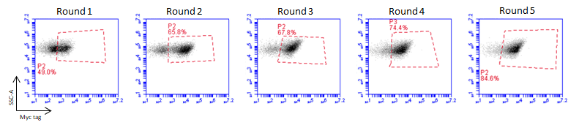
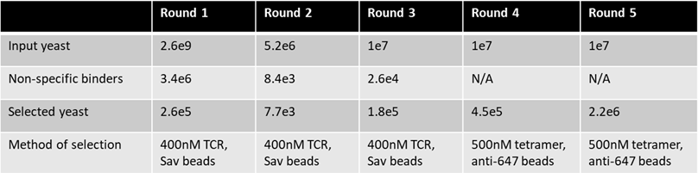
a)
b)
Figure 4. Sample selection data for TCR deorphanization. a) Myc epitope tag staining shows enrichment over successive rounds of selection (gated on unstained yeast). b) Selection scheme and data for five rounds of selection on a randomized 9mer library displayed by mouse MHCI H-2Db. In this example, ‘spot check’ of a dozen colonies following round 3 indicated enrichment of three peptides.

Slide 5
i5 Anchor
F Primer
NNNNNN
Peptide
NNNNNN
R Primer
BC
i7 Anchor
Figure 5. Amplicon sequencing formatting. Short randomized sequences for cluster identification are indicated as “NNNNNN”.
Abbreviations: F primer = Forward NGS primer; R primer = Reverse NGS primer; BC = Index Barcode; “N” indicates any nucleotide

